Slide 1
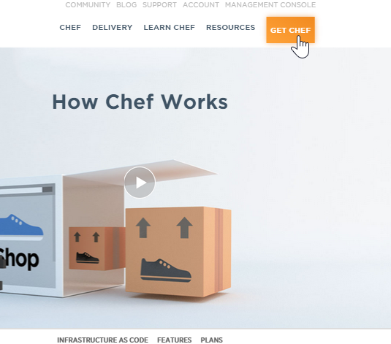
Signing Up for a Hosted Chef Account
Steps
Navigate to https://www.chef.io/chef/
From the resulting window, click Get Chef.

Slide 2
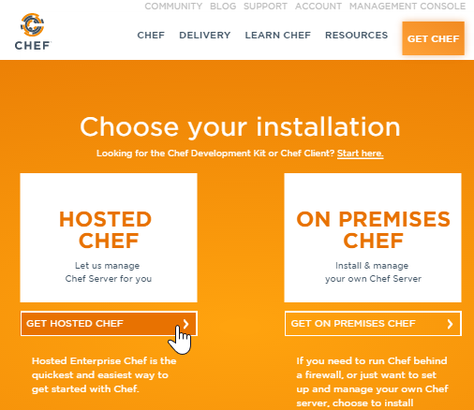
Signing Up for a Hosted Chef Account
Steps
From the resulting window, click the Get Hosted Chef button.

Slide 3
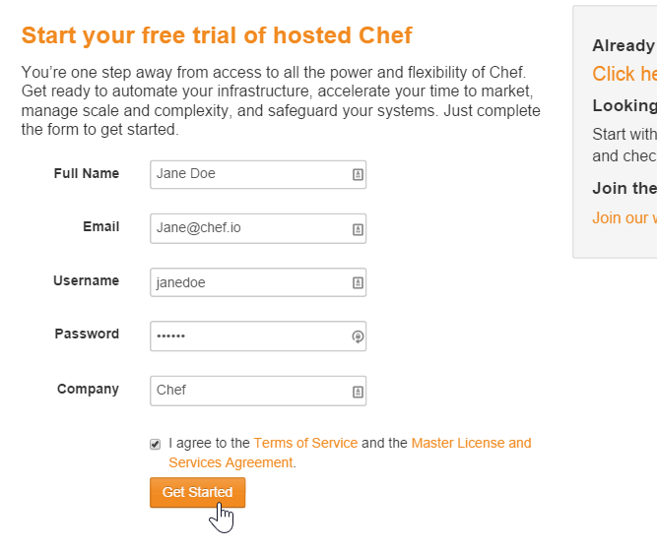
Signing Up for a Hosted Chef Account
Steps
Fill out the form as indicated in this image using your name and a valid email address and then click Get Started.
Note: You should write down your new user name and remember your password.

Slide 4
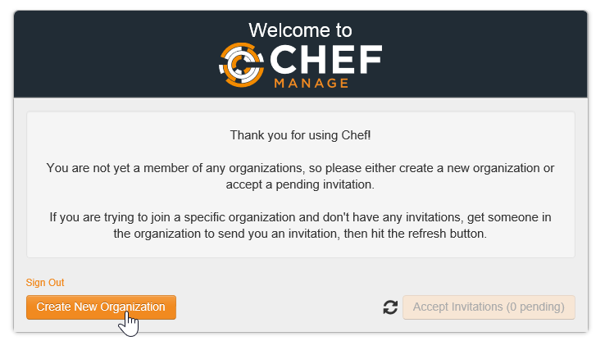
Signing Up for a Hosted Chef Account
Steps
From the resulting page, click the Create New Organization button.

Slide 5
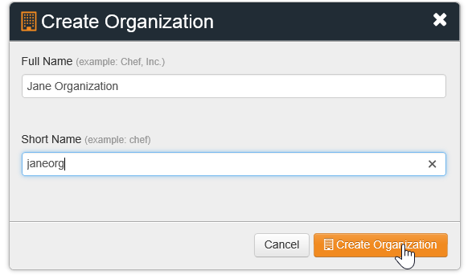
Signing Up for a Hosted Chef Account
Steps
Fill out the resulting Create Organization form and then click Create Organization.

Slide 6
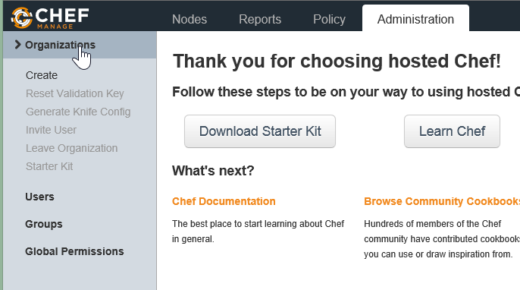
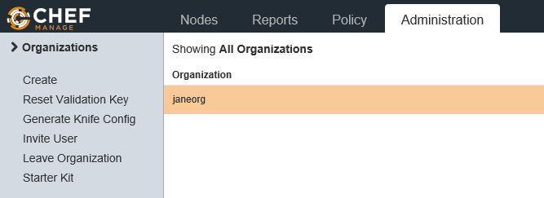
Signing Up for a Hosted Chef Account
Steps
From the resulting page, click the Organizations link to see your new organization.

Slide 7
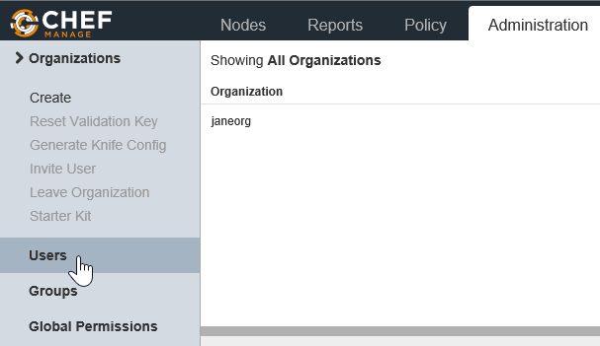
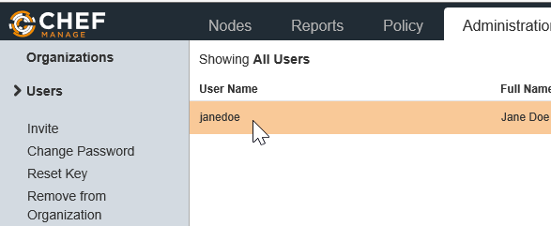
Signing Up for a Hosted Chef Account
Steps
Click the Users link in the left column and then click your Organization User Name to highlight it.

Slide 8
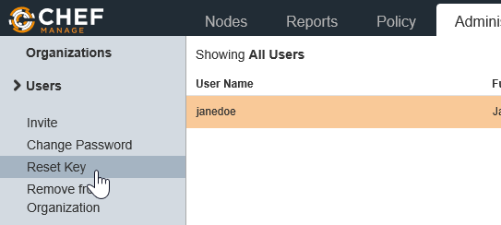
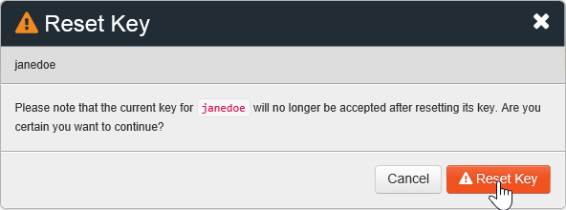
Signing Up for a Hosted Chef Account
Steps
Click the Reset Key link to reset your user key.
On the resulting window, click the Reset Key button.

Slide 9
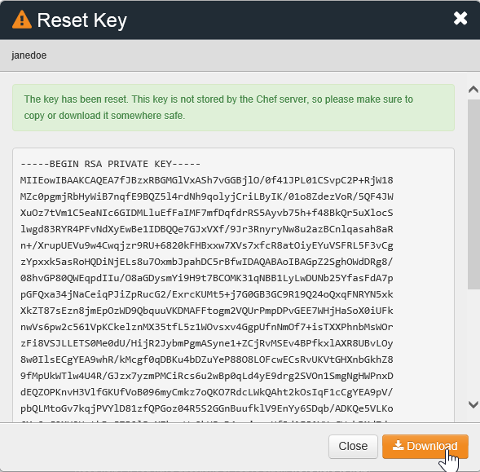
Signing Up for a Hosted Chef Account
Steps
From the resulting Reset Key window, click the Download button.
After downloading, copy the new key to your local chef-repo > .chef directory on your workstation.

Slide 10
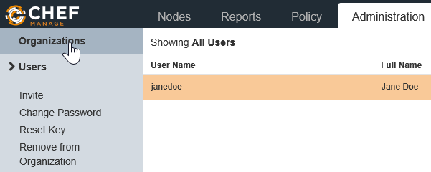
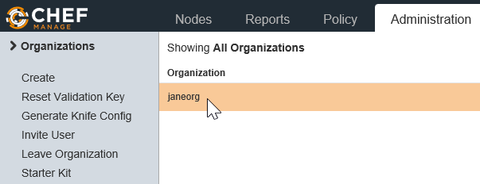
Signing Up for a Hosted Chef Account
Steps
From the remaining window, click Organizations in the left margin.
Click your Organization name to highlight it.

Slide 11
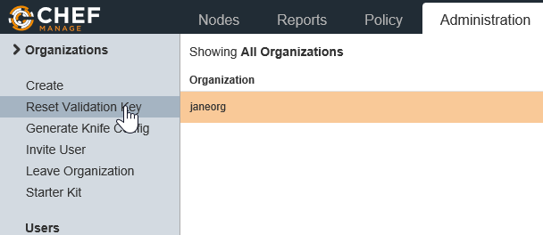
Signing Up for a Hosted Chef Account
Steps
Click the Generate Knife Config link in the left margin and save the knife file.
After downloading the knife file, copy it to your local chef-repo > .chef directory on your workstation.

